Slide 1
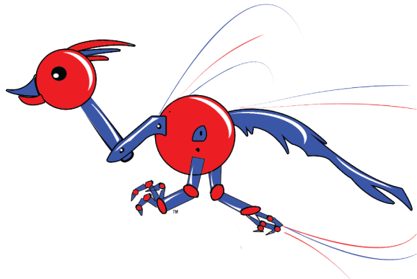
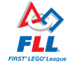


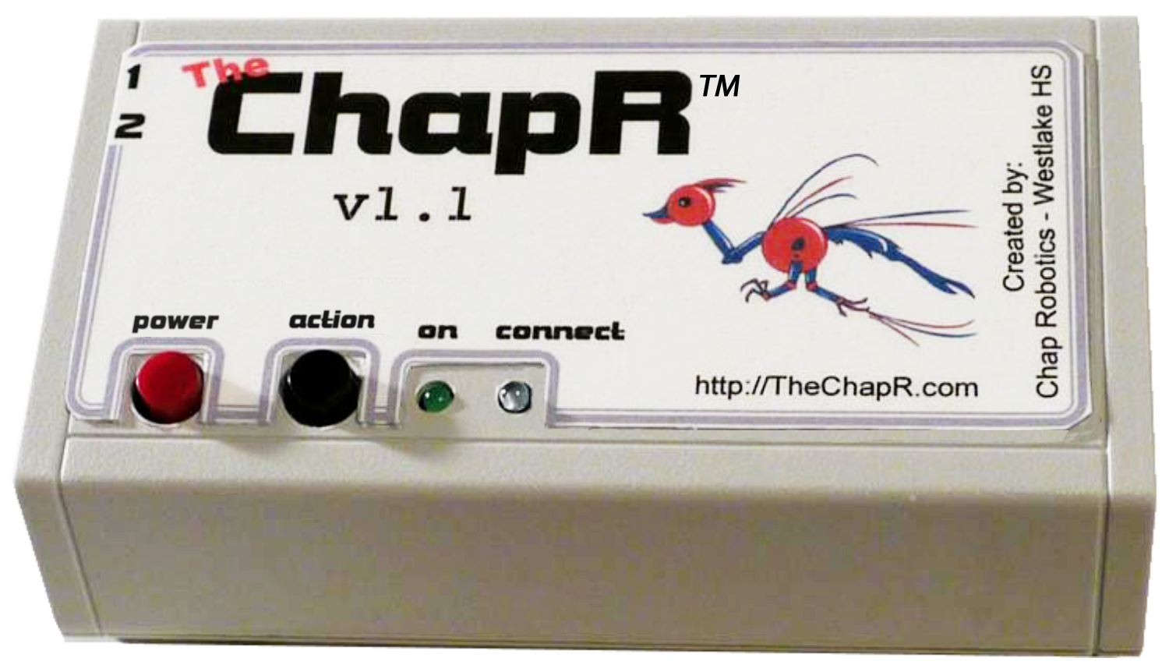
Chap Robotics
FTC 3781
FRC 2468
Creator of
Drive any NXT robot
FTC drive practice without a PC
FRC compatible
Quick connection
Patent pending
ChapR
The

Slide 2
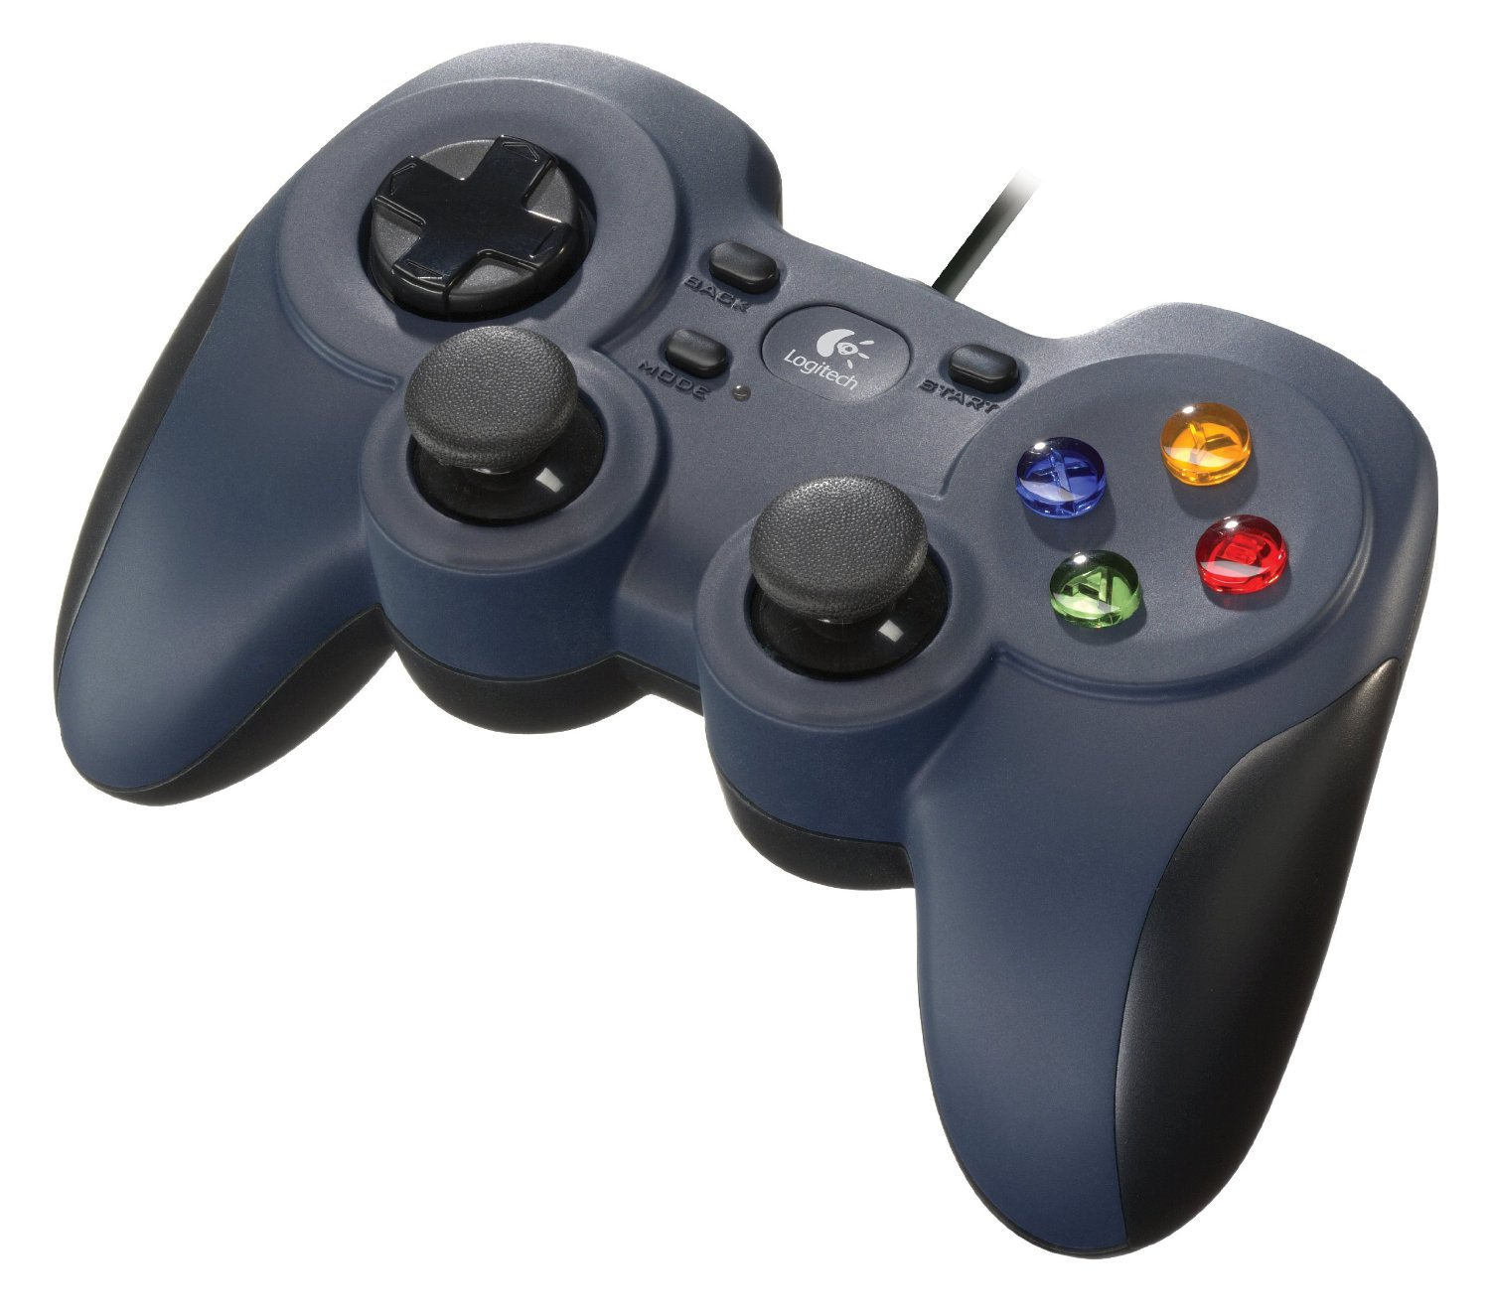
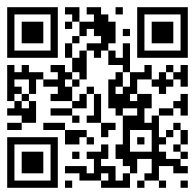
Chap Robotics
FTC 3781
FRC 2468
Creator of
Drive any NXT robot
FTC drive practice without a PC
FRC compatible
Quick connection
Patent pending
Bluetooth remote control!
Patent pending!
Compatible with FLL, FTC and FRC!
Used for testing, practice, demos, education and more!

Slide 3
